Slide 1
GPU Architecture meeting 2

Slide 2
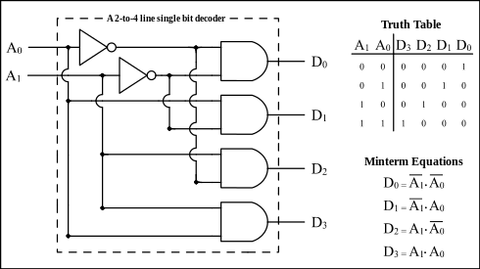
Additional Hardware
As promised last time
Decoder
Changes N width input into 2^{N} width, with single bit enabled
Useful for selecting one of 2^{N} from N bits

Slide 3
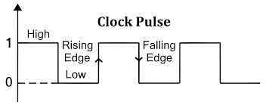
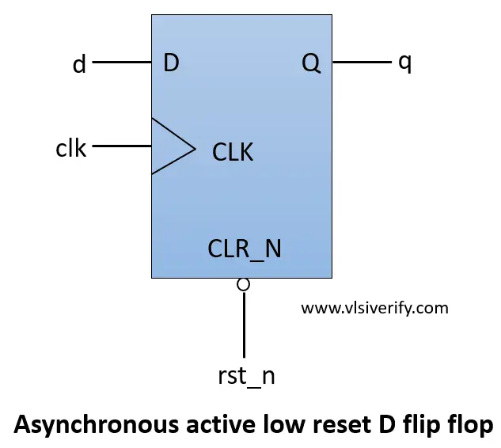
Additional Hardware
Hugely important!!!!
D- FlipFlop
Holds onto input for whole clock cycle
Takes new input @ (positive or negative) clock edge
Enables a lot of computing

Slide 4
Today’s Goals
Learn all about the next pieces of our processor
Instructions and Instruction Cycle
What/why
Instruction set
Registers
ALU

Slide 5
Exercise
What does this number mean?
10001011000000100000000001000001

Slide 6
Binary Refresher
0 and 1 only, pay attention to places
1101
To understand what number this is, we can take a sum of 2^{x}, where x is the place of the number

Slide 7
Binary Refresher
0 and 1 only, pay attention to places
We have a 1 in the zero’s, two’s, and three’s places
So we can sum this as (1)2⁰ + (0)2¹ + (1)2² + (1)2³
1 + 0 + 4 + 8 = 13
Place | 3 | 2 | 1 | 0
Value | 1 | 1 | 0 | 1

Slide 8
Binary Refresher
What about negative numbers?
Sign Magnitude
Most Significant Bit denotes sign
Rest denotes magnitude
Two’s Complement
Read the same, but different process
Flip all bits, add 1
This is how most computers do it because it makes subtraction (more on this later)

Slide 9
Binary Refresher
So 1101 can be
Read as is: 1101 = 13
Sign Magnitude: 1101 = - (2²+2⁰) = -5
Two’s Complement: 1101 = - (0010 + 1) = - (0011) = -3
For our purposes, use online converters if necessary

Slide 10
Exercise (cont.)
Maybe we know what this is now?
10001011000000100000000001000001
Maybe it’s negative?
SM: -184680513
2’s comp: -1962803135
Or maybe this isn’t just a really big number

Slide 11
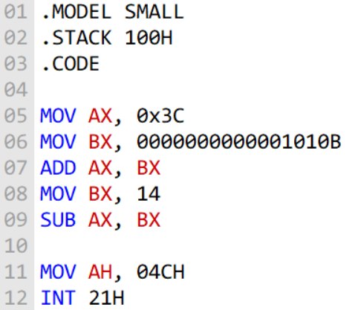

Assembly Languages
Processor’s toolbox
Near 1:1 with machine code
Still kind of human readable
Designed and licensed out for processor dev
Intel’s x86, ARMv8
AMD RDNA and NVIDIA PTX for GPUs
Instruction Set Architecture
Every Instruction the processor can do

Slide 12
Assembly Languages cont.
Basics
Opcode – binary designated as a instruction type, bit width varies
ADD, SUB, for example
Rd, Rm, Rn – Register operands
Rd is the destination
Rn and Rm are sources (nth, mth)
When written, registers denoted as X(number of register)

Slide 13
Exercise (cont.)
So maybe this is assembly?
10001011000000100000000001000001

Slide 14
Exercise (cont.)
So maybe this is assembly? (ARM)
[10001011000][00010][000000][00010][00001]
[ Opcode][ Rm][ Shamt][ Rn][ Rd]
[ ADD][ ][ ][ ][ ]

Slide 15
Exercise (cont.)
So maybe this is assembly? (ARM)
[10001011000][00010][000000][00010][00001]
[ Opcode][ Rm][ Shamt][ Rn][ Rd]
[ ADD][ X2][ 0][ X2][ X1]
This is written in ARM as:
ADD X1, X2, X2 {ADD X1, X2, X2

Slide 16
Expanding on the Instruction Cycle
Parts of a task that a computer needs to complete
Instruction Fetch
Register / Decode
Execute
Memory access
Write back

Slide 17
Instruction Fetch
All instructions are kept in what’s called instruction memory
Essentially a queue of instructions to be completed
Pull a new one every clock cycle
Length of instruction depends on design

Slide 18
Registers/Decode
Given an instruction from ifetch
Continuously hold data across clock cycles
From 2^{N} registers, output the data from one
Be able to single out a register out of 2^{N} to write to from N bits

Slide 19
Execute
Given two data inputs of [ ] length + the instruction
Correctly compute addition, subtraction, and logical operations
Raise flags given correct circumstance
Select output based on encoded instruction

Slide 20
Team split
All together
Decide ISA (instruction dimension impacts every other decision)
Register | ALU
Make Registers that hold data Make Mux that selects and outputs data from register Make decoder that selects a register to write | Make logic necessary for arithmetic (adder), and any desired logic Make mux that chooses output

